Slide 1

Team ID: 25940
Team Name: HEAPIFIERS
No. of Members: 6
Team Leader Name: CHINTHA MANISH KUMAR
Problem Statement ID: PK851

Slide 2
Details of all Team Members
SN | Team Member Name | Role | College Passing Year
1 | CHINTHA MANISH KUMAR | LEADER | 2024
2 | SAGAR LALWANI | MEMBER | 2023
3 | PAREPALLI VENKAT CHARAN | MEMBER | 2024
4 | MOHAMMED MUBASHIRUDDIN | MEMBER | 2024
5 | GOLI PRERANA | MEMBER | 2024
6 | EGA PUJITHA | MEMBER | 2024
7

Slide 3
Idea Description (5 to 6 lines)
Scholarships, other government benefits becoming hard to reach people in remote places.
The optimized solution to this problem is to use the (Anytime Scholarship Service)ATSS system.
A volunteer operates this ATSS system.
Volunteer verifies beneficiary and gives scholarship amount.
ATSS provide an interface between volunteer and beneficiary.
It is a simple, secure and affordable way.

Slide 4
Innovative Idea Solution (50 Words)
To build an offline portal for DBTs of scholarships we’ve used power line carrier communication (PLCC) through which we can transfer data without any network.
As the information received by the ATSS, volunteer reaches the beneficiary and verify to provide the said scholarship amount. This verified details are later sent to the receivers as soon as it is connect to the PLCC.
The data flow through power lines is encrypted that ensures the safe transfer of data.
ATSS is provided with separate officer and volunteer portals to manage the access.

Slide 5
Reference Architecture / Solution Architecture (50 Words)
ATSS made with raspberry pi is preloaded with software and is connected to the LCD for UI.
Finger print scanner and a battery are connected directly to the raspberry pi Helps ATSS running in isolated conditions.
This portable model can be easily carried and used.
This product can also be used for making many other devices too , hence avoiding the wareout nature of hardware.
It’s external architecture consists of a charging port helping in easy charge of battery and a hdmi port to access developer settings protected by password and fingerprint.

Slide 6
Technology Stack
ATSS being a hardware component is associated with user interface
In this ATSS model we have used raspberry Pi OS.
Programming Language used here is python.
Python pyqt5 package is used to design user interface.
Local database using MySQL, JSON And Google firebase as cloud database (to depict server) were used.
Arduino Uno/ Nano
Fingerprint Scanner, Webcam
PLCC – KQ Device

Slide 7
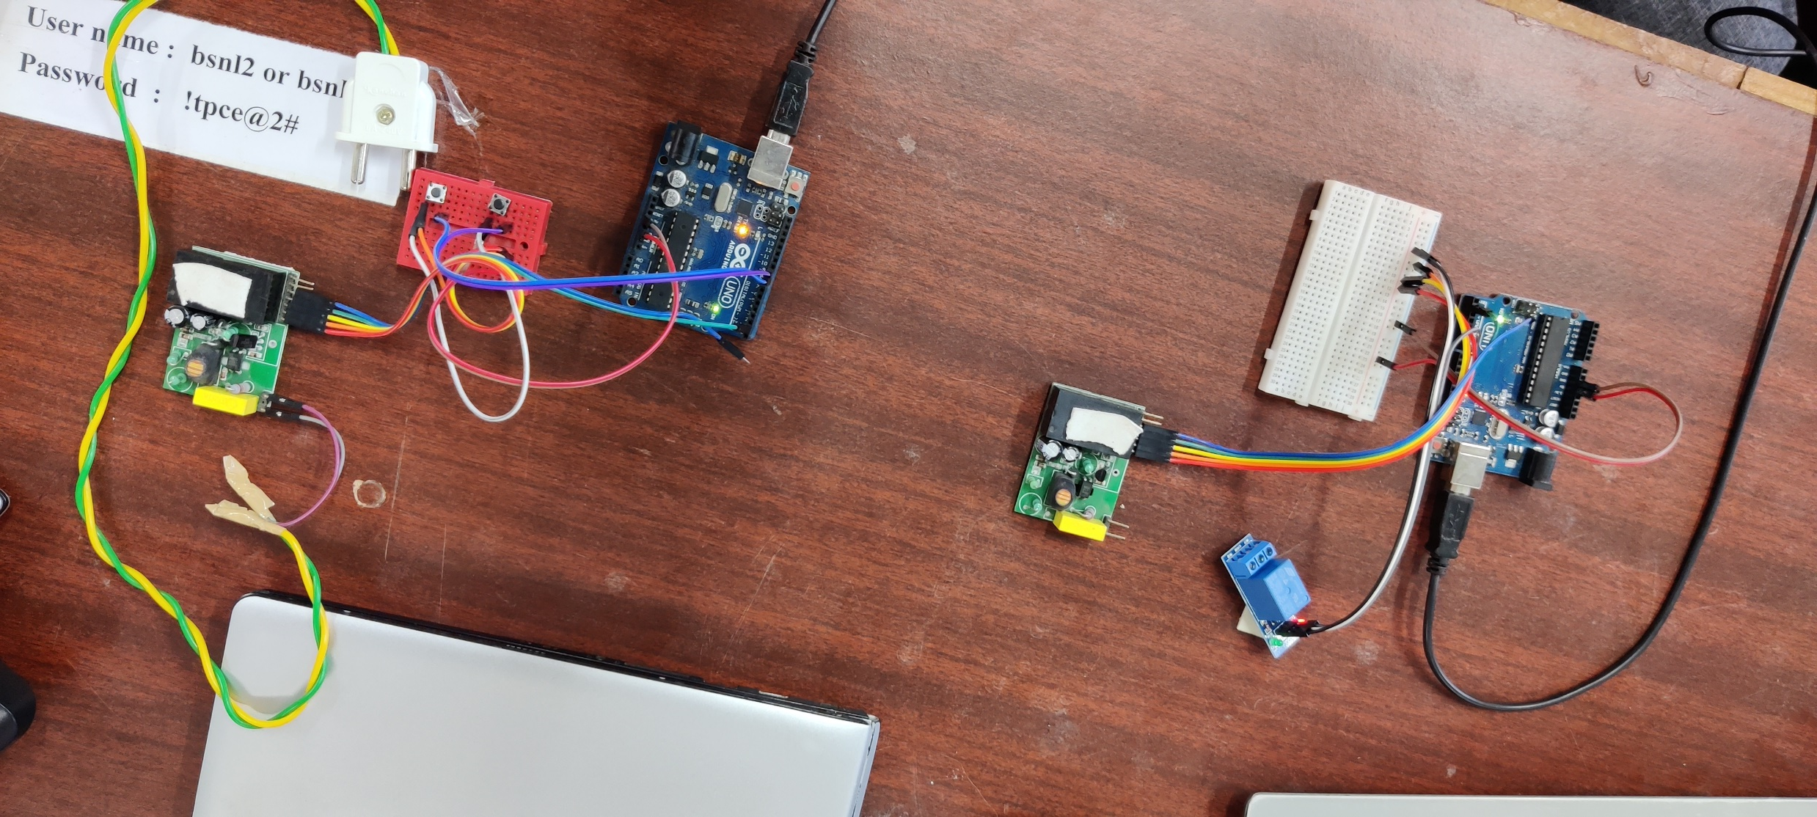
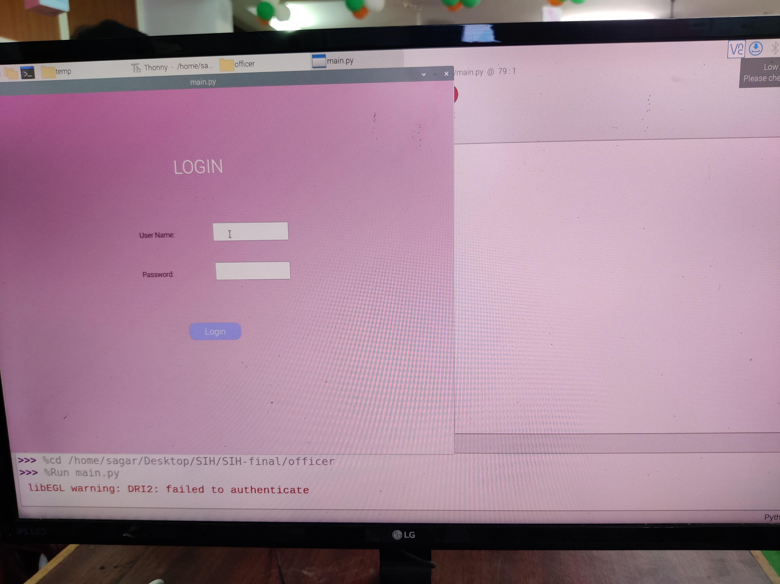
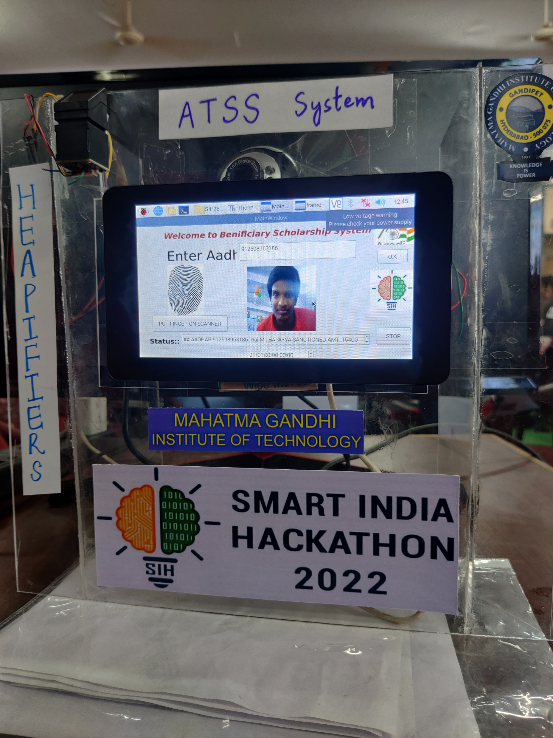
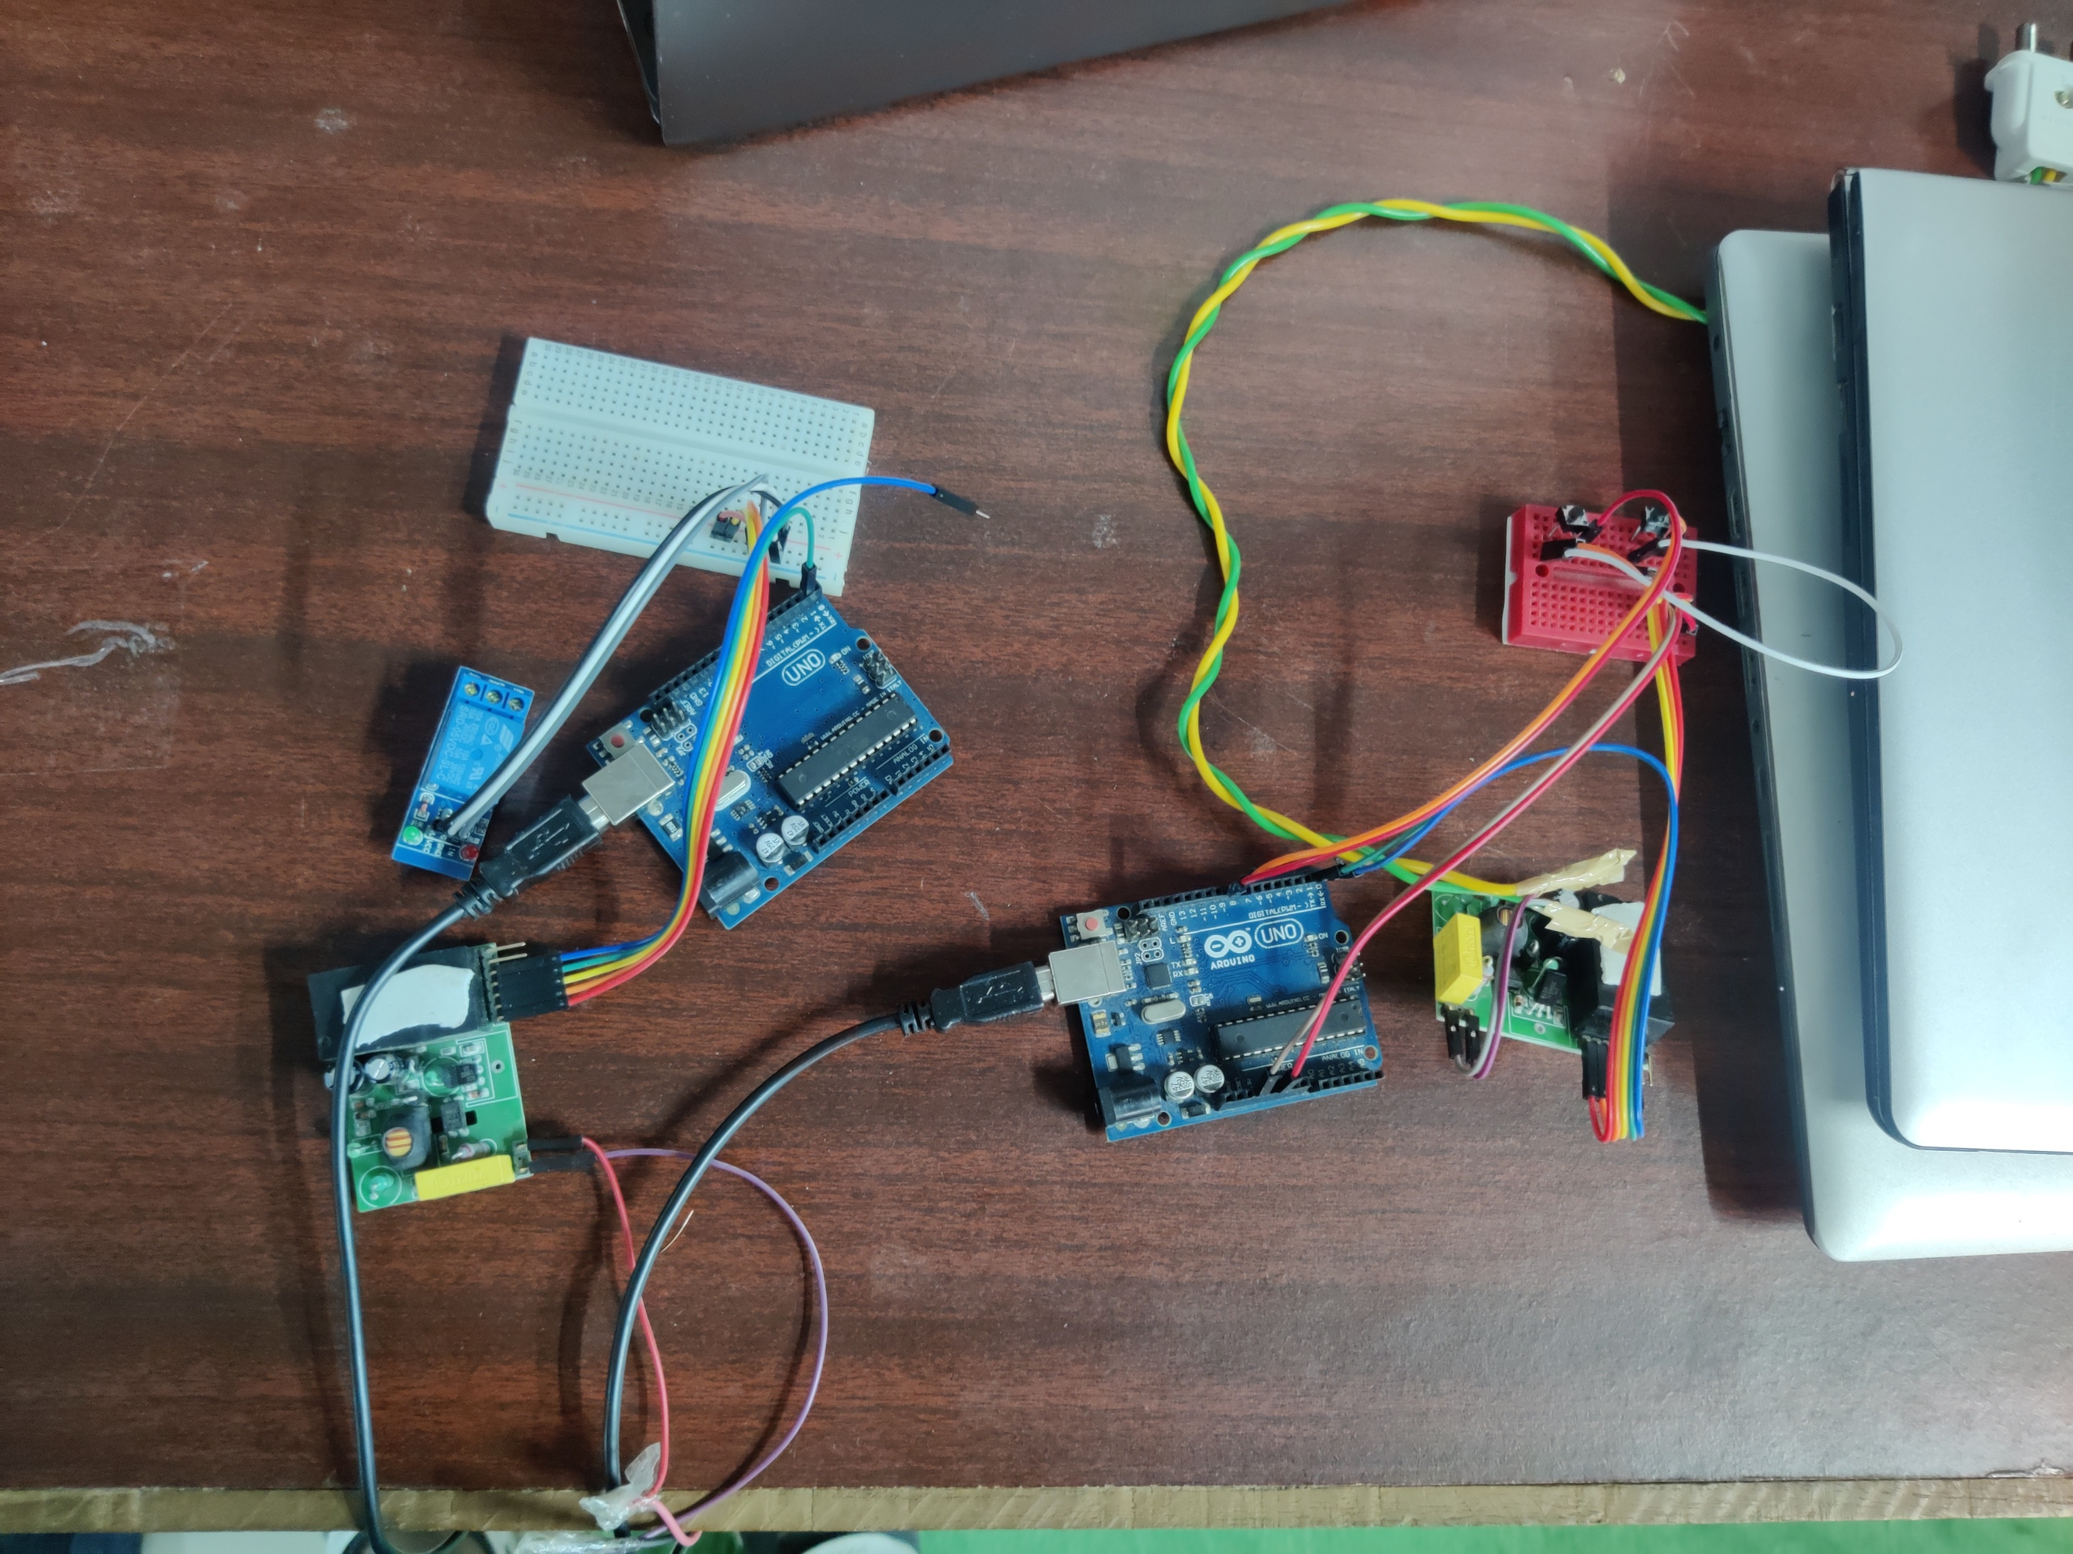
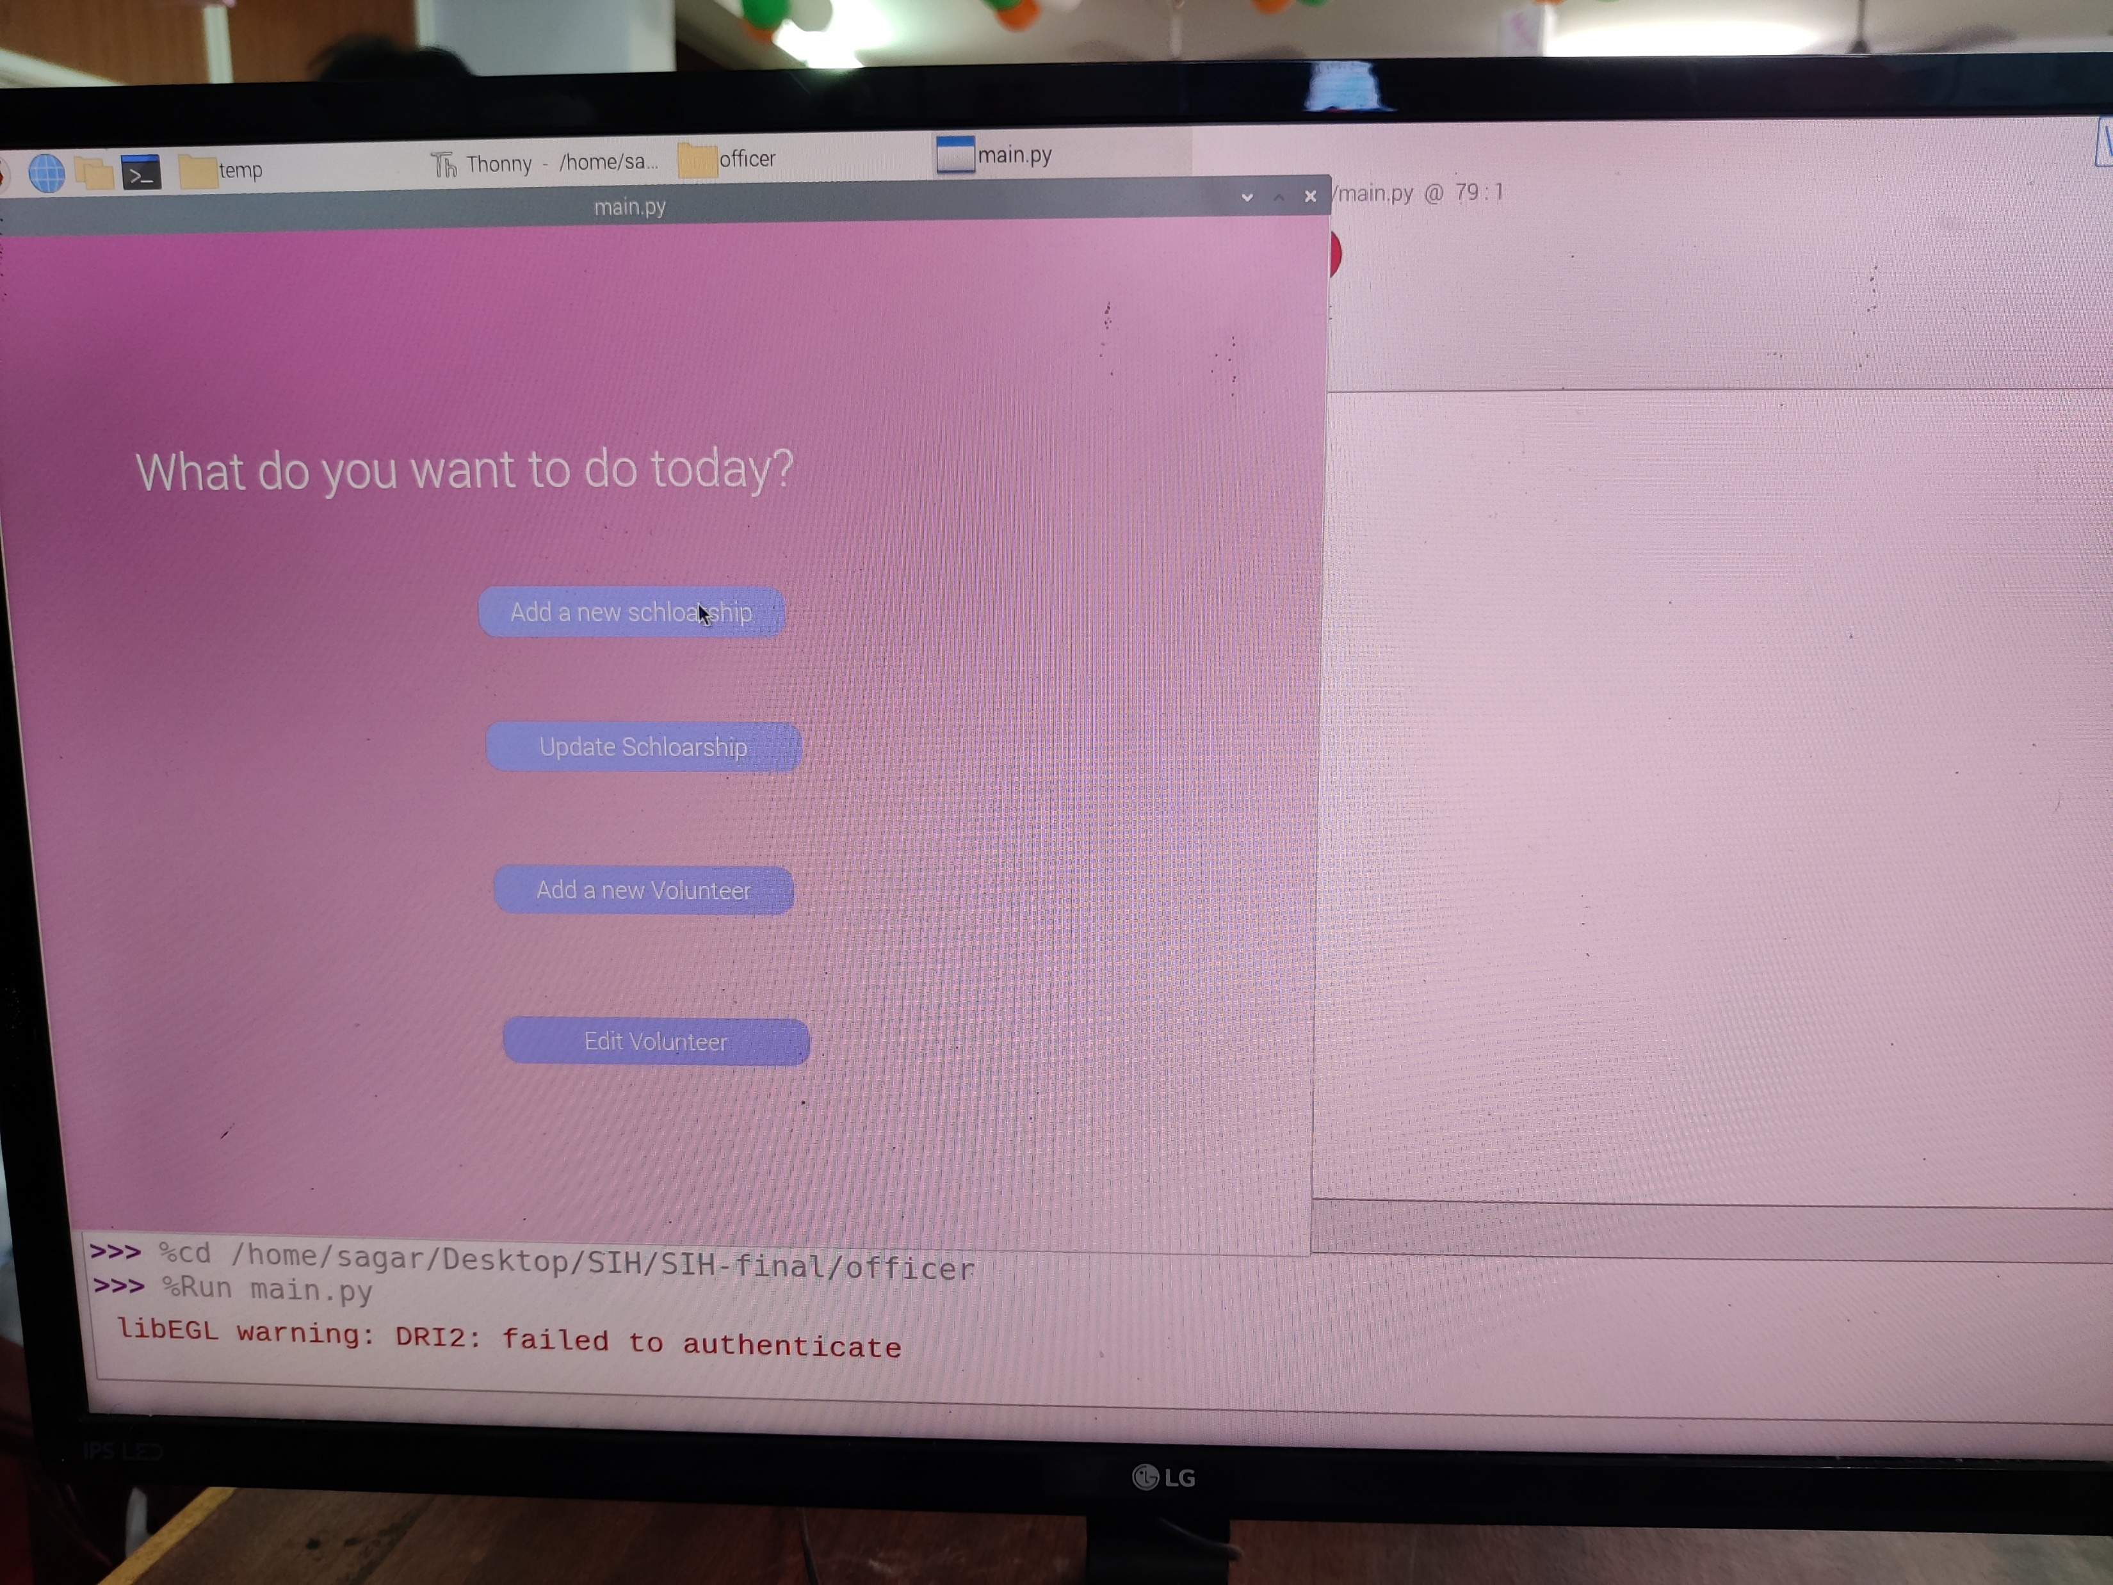
Images / Screenshots of the working prototype

Slide 8
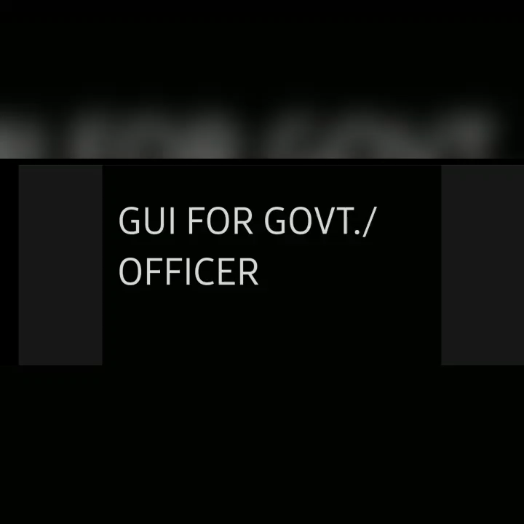
Video of Working Prototype (High resolution - <1min)
https://drive.google.com/file/d/1f3OOsHfkPvcoPClGvfgIa5n19So9Vn5o/view?usp=sharing

Slide 9
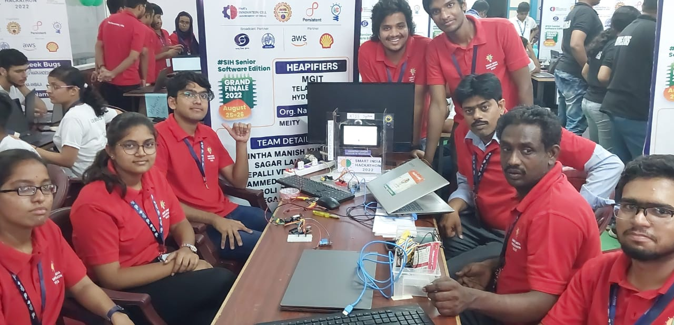
Group Picture of all Participants with Developed Prototype (High Resolution) (If possible in SIH Tee-shirts)

